Slide 1
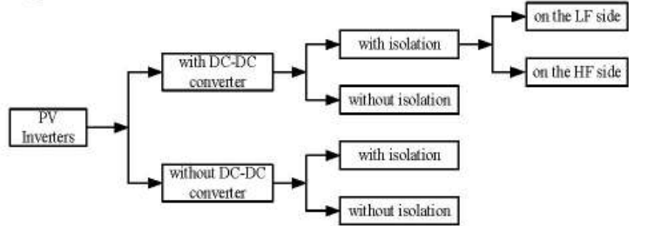
TOPOLOGIES OF PV INVERTER

Slide 2
NEED OF ISOLATION TRANSFORMER
An isolation transformer is slightly different to the standard transformer in that its chief purpose is to isolate two different electrical circuits. Simply, it isolates the load from its power supply, and this can be extremely useful when engineers need to separate equipment from a power source. These transformers manage to do so while also transferring electricity from the source to the device.
ADVANTAGES
Safety
Noise
Surge Protection
Improved Quality of Power

Slide 3
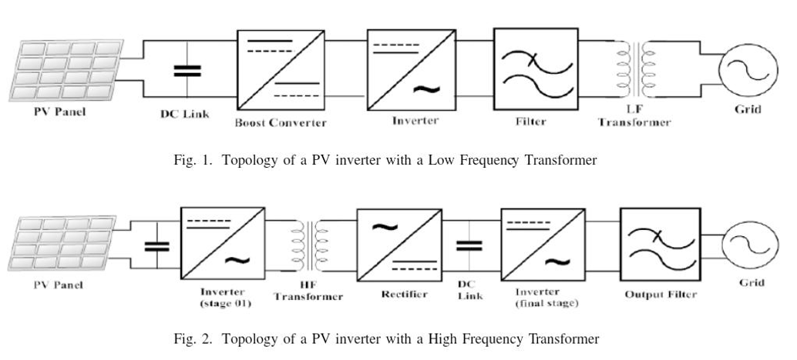
PV inverter with DC-DC converter and Isolation

Slide 4
PV INVERTERS WITH ISOLATION TRANSFORMER
PV inverters with isolation transformers use a transformer to provide galvanic isolation between the PV array and the grid or load, and they can be implemented either at low frequency (LF) or at high frequency (HF).
LF transformer PV inverters
In LF inverters, the PV array DC is first boosted (optionally by a DC–DC stage) and then converted to AC at 50/60 Hz, with a line‑frequency transformer providing isolation between PV modules and the grid.
This makes the system large, heavy, more expensive and less efficient, but very robust and less prone to DC current injection, and suitable for off‑grid applications with high peak‑power demands.

Slide 5
LF transformer PV inverters
PV array
Generates dc power with a voltage that varies with irradiance and temperature.​
Often too low and variable for direct grid connection, so later stages adapt it.​
(Optional) DC‑DC boost converter
Raises and regulates the PV voltage to a suitable dc level and performs MPPT so the array operates at its maximum power point.​
Provides a relatively constant dc link for the inverter despite changing PV conditions.
Low‑frequency (50/60 Hz) inverter
Converts the dc‑link voltage into low‑frequency AC, typically using an H‑bridge with PWM.​
Produces a waveform that, after filtering and transformation, matches grid frequency and is synchronized for grid connection.

Slide 6
LF transformer PV inverters
AC filter and grid/load connection
Filters high‑frequency switching harmonics from the inverter output so the current injected into the grid is nearly sinusoidal and within THD limits.​
Provides measurement and protection (relays, breakers, anti‑islanding) for safe interconnection with the utility or local load.
LF isolation transformer
Operates at grid frequency (50/60 Hz) and provides galvanic isolation between PV side and grid, blocking DC and common‑mode currents.​
Also steps voltage up or down so the inverter can use a convenient DC‑link level while still meeting grid voltage requirements, at the cost of large size, weight, and core losses.​
Notes:
THD stands for Total Harmonic Distortion

Slide 7
HF transformer PV inverters
PV array
Generates DC power with a voltage that varies with irradiance and temperature.​
Often too low and variable for direct grid connection, so later stages adapt it.
DC‑DC high‑frequency converter
First converts the PV DC into high‑frequency AC (tens of kHz) using a switching bridge (e.g., full‑bridge or half‑bridge).​
This HF AC is suitable for a much smaller transformer and usually incorporates MPPT in its control to keep the PV array at optimum operating point.
HF isolation transformer
Provides galvanic isolation and required voltage step‑up or step‑down at high frequency, so for the same power its core and windings can be much smaller and lighter than an LF transformer.​
Helps meet safety standards while improving power density and often reducing cost for a given rating.​

Slide 8
HF transformer PV inverters
High‑frequency rectifier / DC‑link stage
Converts the HF transformer secondary AC back to DC using diodes or synchronous switches and smooths it with capacitors to form a stable DC link.​
Sets the DC voltage level that the final grid‑tie inverter will use, decoupling PV and grid constraints.​
Grid‑connected inverter stage
Takes the isolated DC‑link voltage and generates grid‑frequency AC with controlled amplitude, phase, and frequency, often using a two‑level or multilevel VSI.​
Implements current control, power‑factor control, and grid‑support functions (e.g., reactive power, ride‑through) while tracking grid synchronization.​
AC filter and grid/load connection
LC or LCL filters attenuate switching harmonics from the grid‑tie inverter to meet power‑quality standards.​
Protection and relays ensure safe connection/disconnection, similar to the LF case, but the overall system is lighter, more compact, and typically more efficient because major power transfer occurs at HF instead of 50/60 Hz.
Notes:
Voltage Source Inverter. VSI is a power‑electronic converter that takes a (nearly) constant dc voltage and converts it into an ac voltage with controllable amplitude and frequency.

Slide 9
HF transformer PV inverters
In HF inverters, the PV DC is first converted to high‑frequency AC, passed through a high‑frequency transformer to step up the voltage and provide isolation, and then converted back to AC using rectifier at grid frequency in a final inverter stage.
This architecture yields galvanic isolation like LF systems but with lighter, more compact, inexpensive hardware and higher efficiency compared with LF‑transformer inverters, because the HF transformer is much smaller and has lower losses.

Slide 10
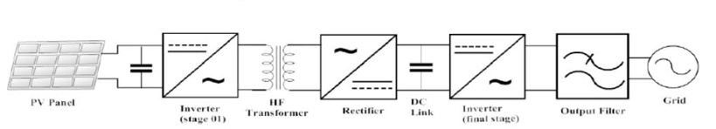
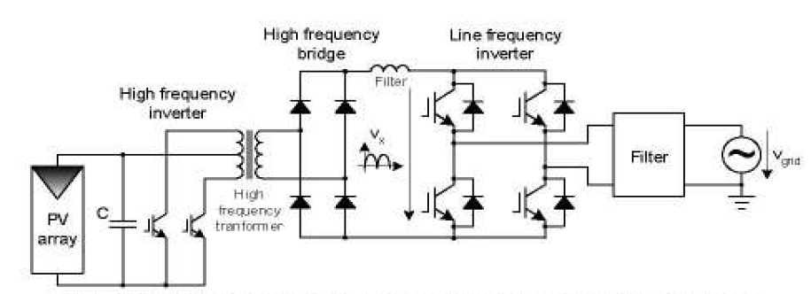
PV inverter with an HF transformer using an isolated push-pull boost converter

Slide 11
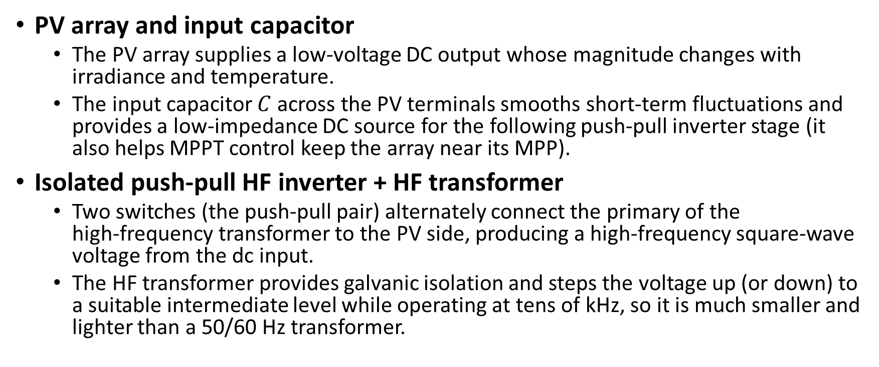
PV inverter with an HF transformer using an isolated push-pull boost converter
PV array and input capacitor
The PV array supplies a low‑voltage DC output whose magnitude changes with irradiance and temperature.
The input capacitor $C$ across the PV terminals smooths short‑term fluctuations and provides a low‑impedance DC source for the following push‑pull inverter stage (it also helps MPPT control keep the array near its MPP).
Isolated push‑pull HF inverter + HF transformer
Two switches (the push‑pull pair) alternately connect the primary of the high‑frequency transformer to the PV side, producing a high‑frequency square‑wave voltage from the dc input.
The HF transformer provides galvanic isolation and steps the voltage up (or down) to a suitable intermediate level while operating at tens of kHz, so it is much smaller and lighter than a 50/60 Hz transformer.

Slide 12
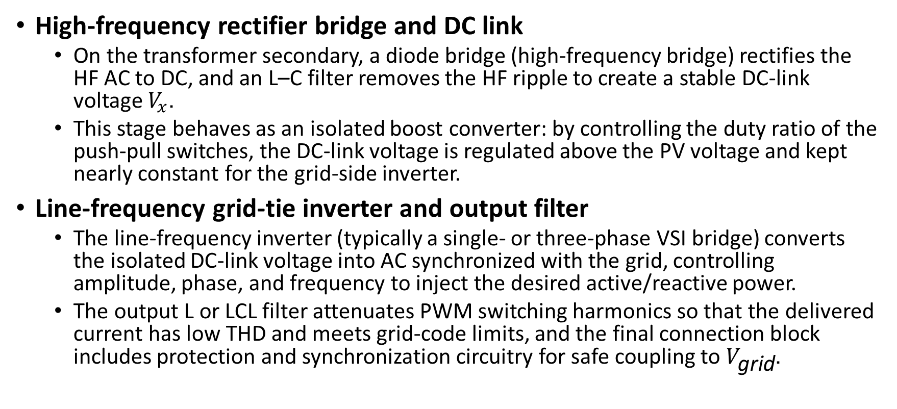
PV inverter with an HF transformer using an isolated push-pull boost converter
High‑frequency rectifier bridge and DC link
On the transformer secondary, a diode bridge (high‑frequency bridge) rectifies the HF AC to DC, and an L–C filter removes the HF ripple to create a stable DC‑link voltage $V_{x}$.
This stage behaves as an isolated boost converter: by controlling the duty ratio of the push‑pull switches, the DC‑link voltage is regulated above the PV voltage and kept nearly constant for the grid‑side inverter.
Line‑frequency grid‑tie inverter and output filter
The line‑frequency inverter (typically a single‑ or three‑phase VSI bridge) converts the isolated DC‑link voltage into AC synchronized with the grid, controlling amplitude, phase, and frequency to inject the desired active/reactive power.
The output L or LCL filter attenuates PWM switching harmonics so that the delivered current has low THD and meets grid‑code limits, and the final connection block includes protection and synchronization circuitry for safe coupling to $V_{\text{grid}}$.

Slide 13
PV inverter with an HF transformer using an isolated push-pull boost converter
DC-AC inverter is a low-cost inverter switched at the line frequency.
In order to keep the magnetic components small high switching frequencies in the range of 20 — 100 kHz are typically employed.
The full-bridge converter is usually utilized at power levels above 750 W.
The advantages of this topology are:
Good transformer utilization bipolar magnetization of the core
Good performance with current programmed control — reduced DC magnetization of transformer.
The main disadvantages in comparison with push-pull topology are
Higher active part count
Higher transformer ratio needed for boosting the DC voltage to the grid level.

Slide 14
PV inverter with an HF transformer using an isolated push-pull boost converter
The single inductor push-pull converter can provide boosting function on both the boosting inductor and transformer, reducing the transformer ratio. Thus, higher efficiency can be achieved together with smoother input current.
On the negative side higher blocking voltage switches are required and the transformer with tap point puts some construction and reliability problems.
Those shortcomings can be alleviated using the double inductor push-pull converter (DIC) where the boost inductor has been split into two. Actually, this topology is equivalent with two interleaved boost converters leading to lower ripple in the input current. The transformer construction is simpler not requiring a tap point. The single disadvantage of this topology remains the need for an extra inductor.

Slide 15
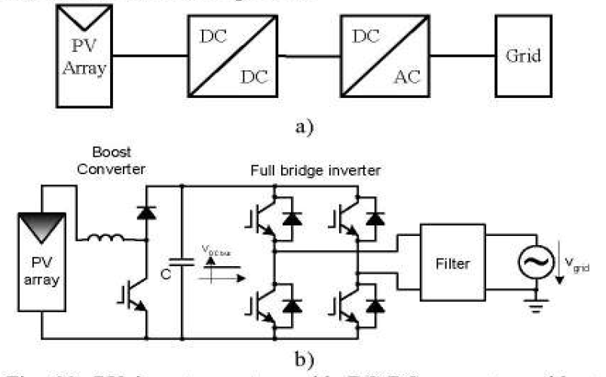
PV inverter with DC- DC converter and no isolation
In some countries as the grid-isolation is not mandatory, more simplified PV Inverter design can be used

Slide 16
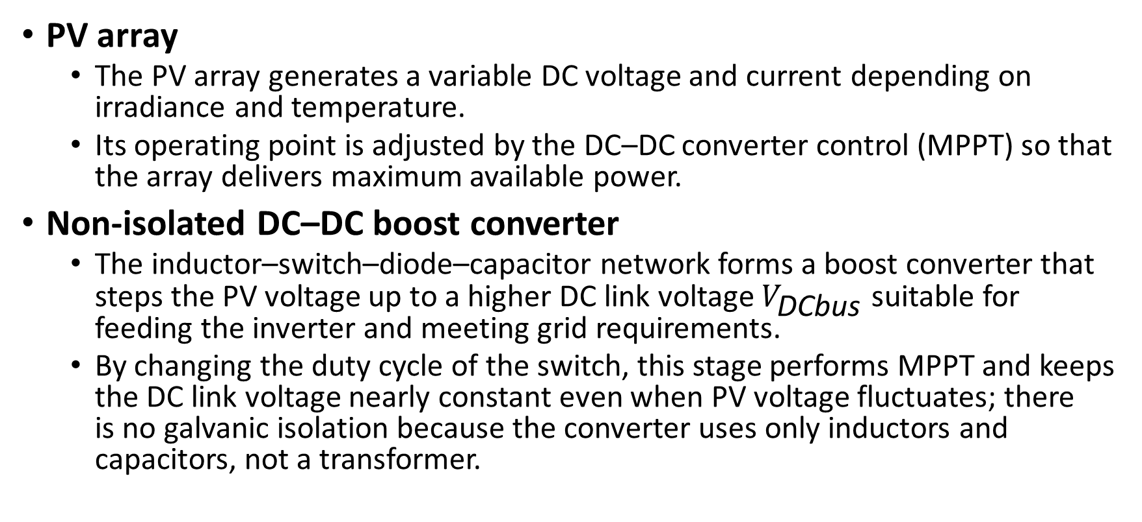
PV inverter with DC- DC converter and no isolation
PV array
The PV array generates a variable DC voltage and current depending on irradiance and temperature.
Its operating point is adjusted by the DC–DC converter control (MPPT) so that the array delivers maximum available power.
Non‑isolated DC–DC boost converter
The inductor–switch–diode–capacitor network forms a boost converter that steps the PV voltage up to a higher DC link voltage $V_{\text{DCbus}}$ suitable for feeding the inverter and meeting grid requirements.
By changing the duty cycle of the switch, this stage performs MPPT and keeps the DC link voltage nearly constant even when PV voltage fluctuates; there is no galvanic isolation because the converter uses only inductors and capacitors, not a transformer.

Slide 17
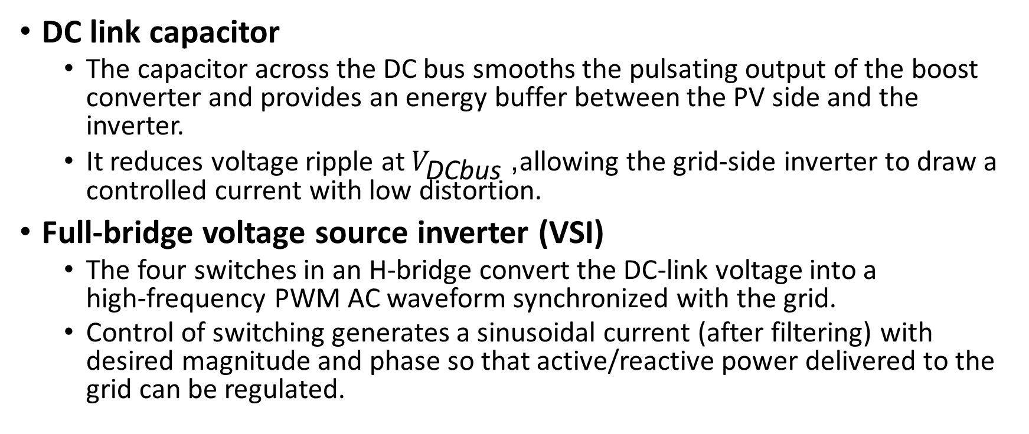
PV inverter with DC- DC converter and no isolation
DC link capacitor
The capacitor across the DC bus smooths the pulsating output of the boost converter and provides an energy buffer between the PV side and the inverter.
It reduces voltage ripple at $V_{\text{DCbus}}$, allowing the grid‑side inverter to draw a controlled current with low distortion.
Full‑bridge voltage source inverter (VSI)
The four switches in an H‑bridge convert the DC‑link voltage into a high‑frequency PWM AC waveform synchronized with the grid.
Control of switching generates a sinusoidal current (after filtering) with desired magnitude and phase so that active/reactive power delivered to the grid can be regulated.

Slide 18
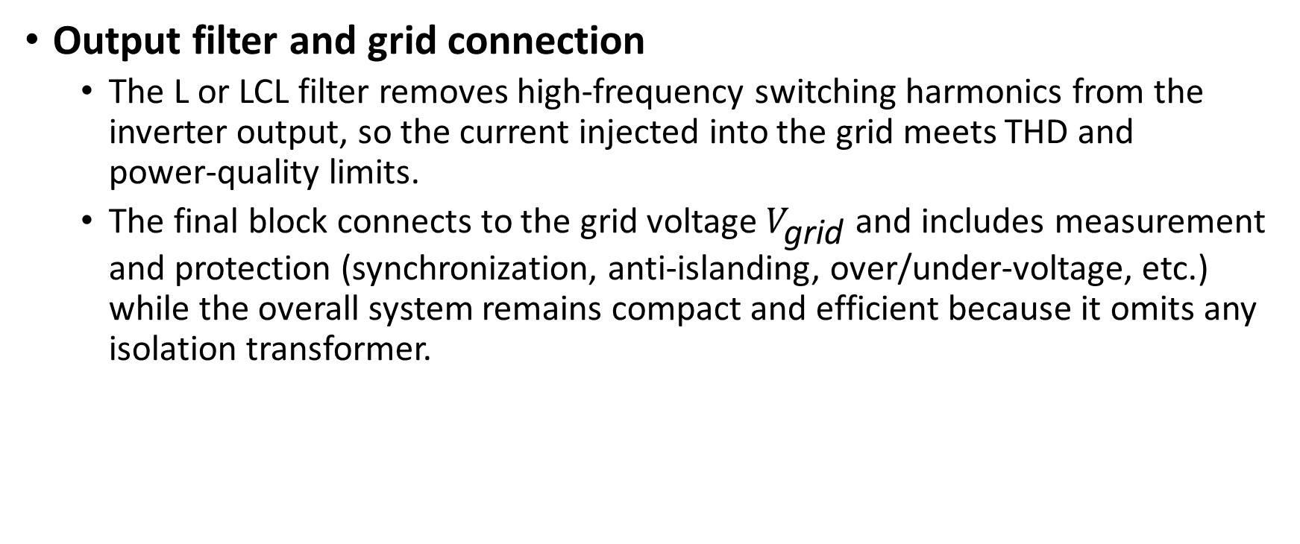
PV inverter with DC- DC converter and no isolation
Output filter and grid connection
The L or LCL filter removes high‑frequency switching harmonics from the inverter output, so the current injected into the grid meets THD and power‑quality limits.
The final block connects to the grid voltage $V_{\text{grid}}$ and includes measurement and protection (synchronization, anti‑islanding, over/under‑voltage, etc.) while the overall system remains compact and efficient because it omits any isolation transformer.

Slide 19
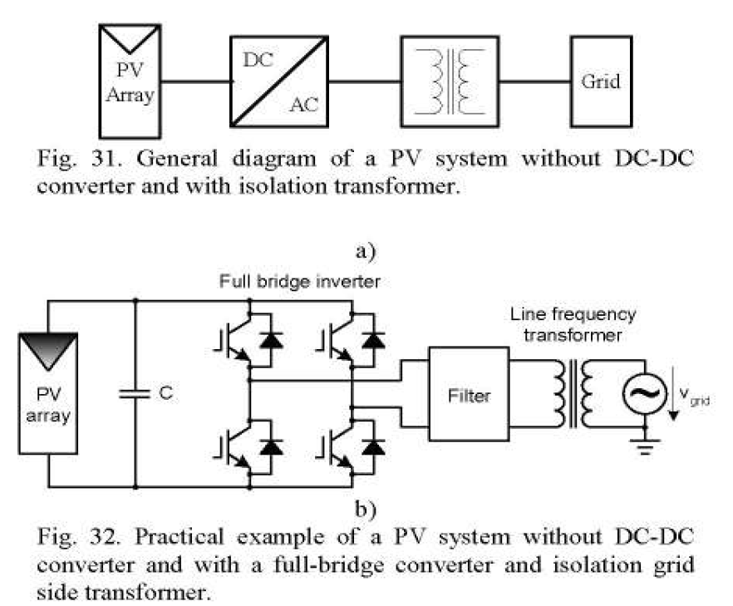
PV inverter without DC - DC converter and with isolation
A typical transformer-less topology using PWM IGBT inverters

Slide 20
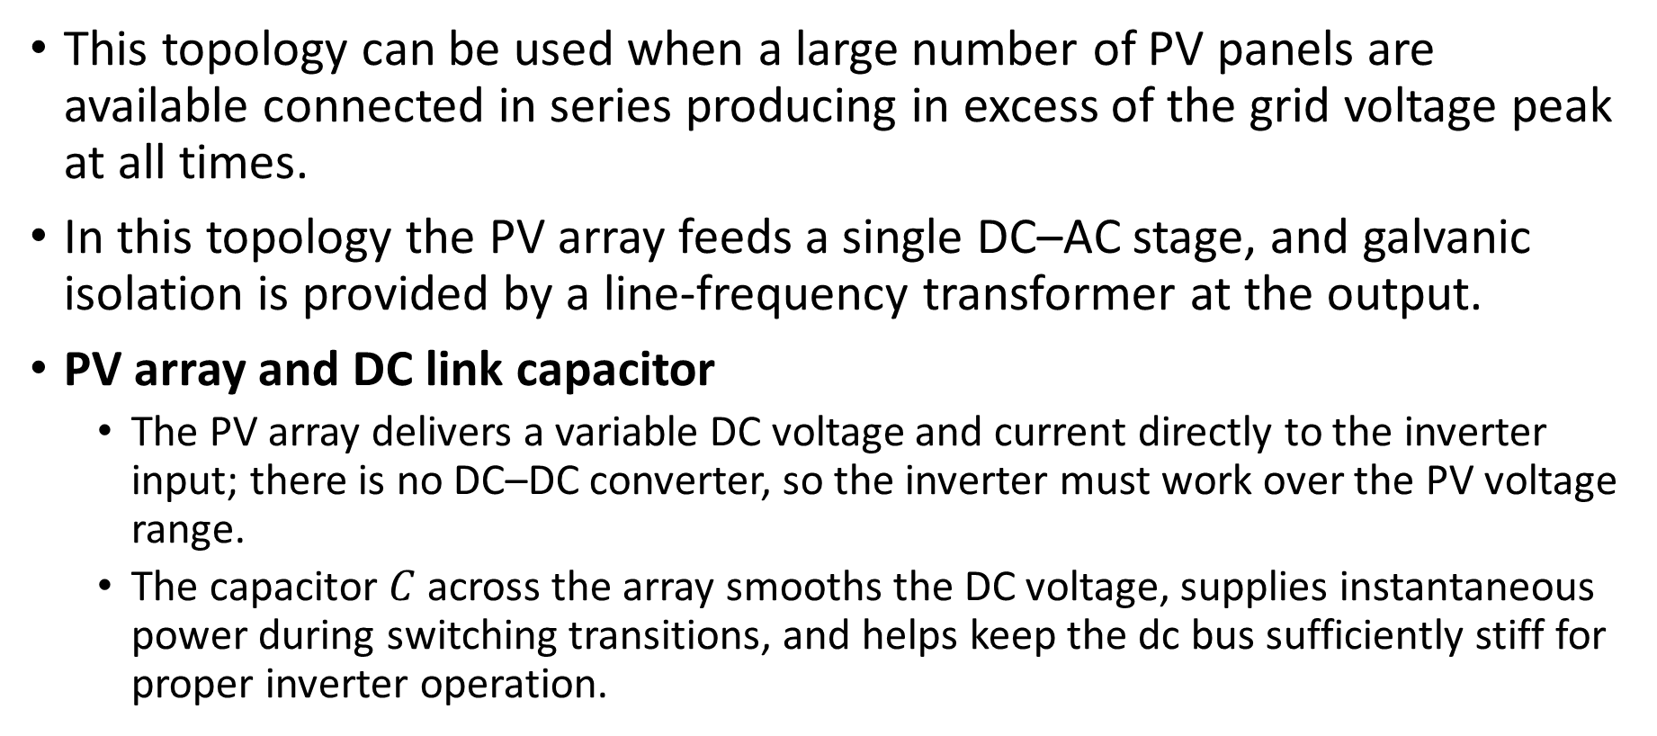
PV inverter without DC - DC converter and with isolation
This topology can be used when a large number of PV panels are available connected in series producing in excess of the grid voltage peak at all times.
In this topology the PV array feeds a single DC–AC stage, and galvanic isolation is provided by a line‑frequency transformer at the output.
PV array and DC link capacitor
The PV array delivers a variable DC voltage and current directly to the inverter input; there is no DC–DC converter, so the inverter must work over the PV voltage range.
The capacitor $C$ across the array smooths the DC voltage, supplies instantaneous power during switching transitions, and helps keep the dc bus sufficiently stiff for proper inverter operation.

Slide 21
PV inverter without DC - DC converter and with isolation
Full‑bridge voltage source inverter
The four switches form a single‑phase full‑bridge that converts the DC from the PV array into a high‑frequency PWM bipolar (or unipolar) AC waveform.
By modulating these switches, the control system shapes the fundamental component of the bridge output so that, after filtering and transformation, it matches grid frequency and supports synchronization and power‑factor control.
AC filter
The filter (typically L or LCL) is placed between the inverter and transformer to attenuate the high‑frequency switching harmonics present in the bridge output.
It ensures that mainly the 50/60 Hz fundamental reaches the transformer, so the current seen by the grid has low THD and meets power‑quality limits.

Slide 22
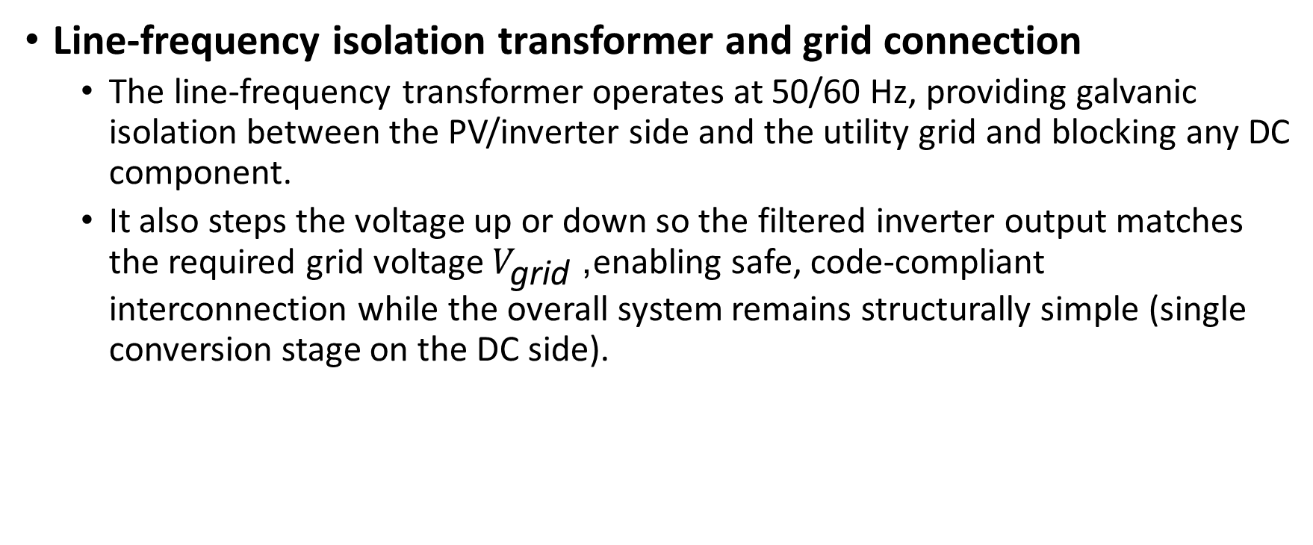
PV inverter without DC - DC converter and with isolation
Line‑frequency isolation transformer and grid connection
The line‑frequency transformer operates at 50/60 Hz, providing galvanic isolation between the PV/inverter side and the utility grid and blocking any DC component.
It also steps the voltage up or down so the filtered inverter output matches the required grid voltage $V_{\text{grid}}$, enabling safe, code‑compliant interconnection while the overall system remains structurally simple (single conversion stage on the DC side).

Slide 23
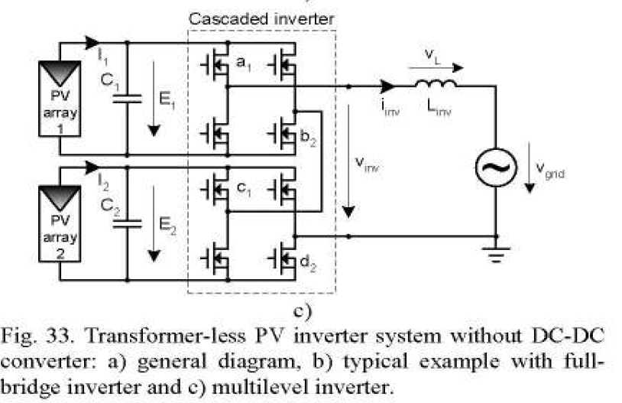
PV inverter without DC - DC converter and without isolation

Slide 24
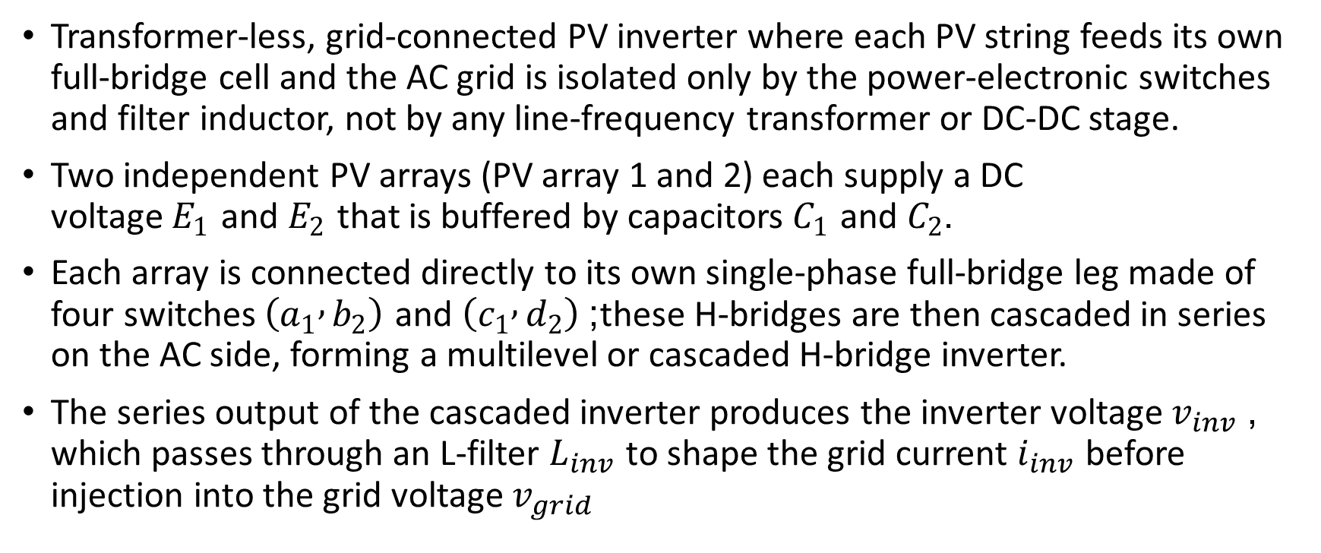
PV inverter without DC - DC converter and without isolation
Transformer‑less, grid‑connected PV inverter where each PV string feeds its own full‑bridge cell and the AC grid is isolated only by the power‑electronic switches and filter inductor, not by any line‑frequency transformer or DC‑DC stage.
Two independent PV arrays (PV array 1 and 2) each supply a DC voltage $E_{1}$ and $E_{2}$ that is buffered by capacitors $C_{1}$ and $C_{2}$.​
Each array is connected directly to its own single‑phase full‑bridge leg made of four switches $\left(a_{1} , b_{2}\right)$ and $\left(c_{1} , d_{2}\right)$; these H‑bridges are then cascaded in series on the AC side, forming a multilevel or cascaded H‑bridge inverter.​
The series output of the cascaded inverter produces the inverter voltage $v_{inv}$, which passes through an L‑filter $L_{inv}$ to shape the grid current $i_{inv}$ before injection into the grid voltage $v_{grid}$

Slide 25
PV inverter without DC - DC converter and without isolation
Operation without DC‑DC converter
There is no intermediate boost or buck DC‑DC stage; instead, each PV array’s DC voltage is used directly by its full‑bridge cell, and appropriate modulation (e.g., sinusoidal PWM) synthesizes the required AC voltage for the grid.​
The cascaded structure allows the effective AC voltage to be the sum of the cell voltages, so the grid‑level amplitude can be met by stacking moderate PV voltages rather than stepping them up with a DC‑DC converter.
Transformer‑less but with isolation
“Transformer‑less” here means no bulky line‑frequency isolation transformer between the inverter and the grid, which improves efficiency and reduces size and cost, but eliminates galvanic isolation between PV arrays and grid.​
Electrical isolation for safety and control is still provided at the signal/power‑drive level (for example by isolated gate drivers and control‑signal transformers), and protection functions ensure that fault currents and leakage through the parasitic capacitance of the PV arrays remain within limits despite the absence of a power transformer.

Slide 26
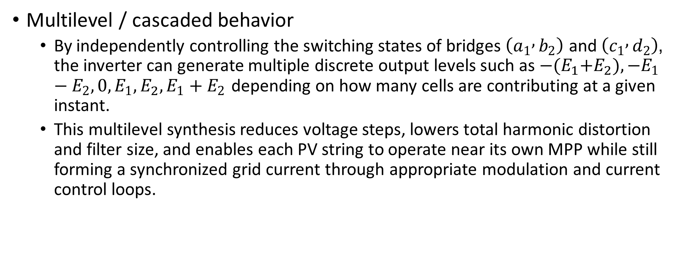
PV inverter without DC - DC converter and without isolation
Multilevel / cascaded behavior
By independently controlling the switching states of bridges $\left(a_{1} , b_{2}\right)$ and $\left(c_{1} , d_{2}\right)$, the inverter can generate multiple discrete output levels such as $−{{{(E}_{1}+E}_{2}), −E}_{1 }−E_{2},0,E_{1},{E_{2}, E}_{1}+E_{2}$ depending on how many cells are contributing at a given instant.​
This multilevel synthesis reduces voltage steps, lowers total harmonic distortion and filter size, and enables each PV string to operate near its own MPP while still forming a synchronized grid current through appropriate modulation and current control loops.

Slide 27
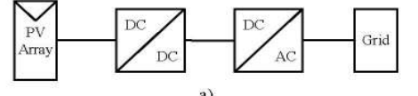
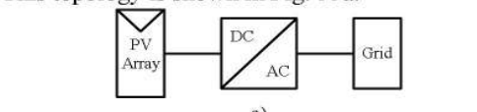


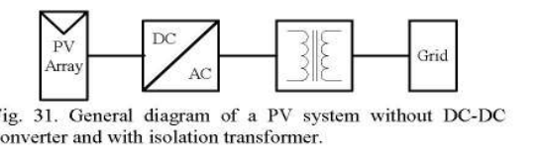
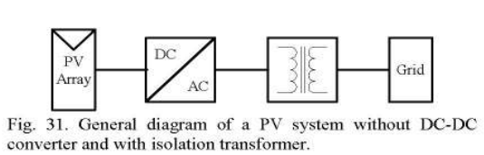
PV INVERTER DC TO DC CONVERTER AND NO ISOLATION

Slide 28
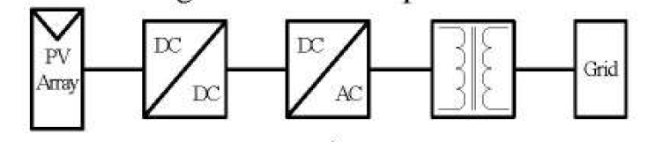
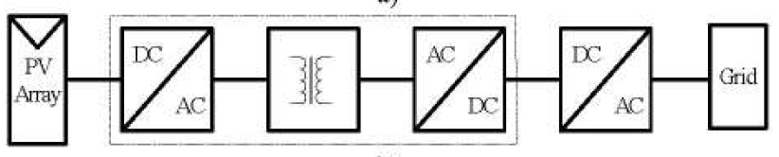
PV inverters with DC-Dc converter and isolation
Figure a
Figure b

Slide 29
PV inverters with DC-Dc converter and isolation
The isolation is typically acquired using a transformer that can be placed on either the grid frequency side (LF) as shown in Fig. a or on the high-frequency (HF) side in the dc-dc convener as shown in Fig. b.
The HF transformer leads to more compact solutions but high care should be taken in the transformer design in order to keep the losses low.

